Slide 1
Australia
Presented by: Melinda Fuferenda
Márk Szélesi
Levente Basaran

Slide 2
Etymology
Pronouncedthe name Australia "southern". The country has been referred to colloquially as Oz since the early 20th century. Aussie is a common colloquial term for "Australian". In neighbouring New Zealand, and less commonly in Australia itself, the noun "Aussie" is also used to refer to the nation, as distinct from its residents

Slide 3
The earliest recorded use of the word Australia in English was in 1625 in "A note of Australia del Espíritu Santo, written by Sir Richard Hakluyt", published by Samuel Purchas in Hakluytus Posthumus, a corruption of the original Spanish name "Tierra Austral del Espíritu Santo" (Southern Land of the Holy Spirit)for an island in Vanuatu.

Slide 4
Human habitation of the Australian continent is estimated to have begun between 42,000 and 48,000 years ago,possibly with the migration of people by land bridges and short sea-crossings from what is now South-East Asia. These first inhabitants may have been ancestors of modern Indigenous Australians.
History

Slide 5
At the time of European settlement in the late 18th century, most Indigenous Australians were hunter-gatherers, with a complex oral culture and spiritual values based on reverence for the land and a belief in the Dreamtime.

Slide 6
The first recorded European sighting of the Australian mainland, and the first recorded European landfall on the Australian continent, are attributed to the Dutch navigator Willem Lanszoon. He sighted the coast of Cape York Peninsula in early 1606, and made landfall on 26 February at the Pennfather River near the modern town of Weipa on Cape York.

Slide 7
The climate of Australia is significantly influenced by ocean currents, including the Indian Ocean Dipole and the El Niño-Southern Oscillation, which is correlated with periodic drought, and the seasonal tropical low-pressure system that produces cyclones in northern Australia.These factors cause rainfall to vary markedly from year to year. Much of the northern part of the country has a tropical, predominantly summer-rainfall (monsoon) climate.The southwest corner of the country has a Mediterran climate.Much of the southeast (including Tasmania) is temperate.
Climate

Slide 8
Australian forests are mostly made up of evergreen species, particularly eucalyptus trees in the less arid regions, wattles replace them in drier regions and deserts as the most dominant species.Among well-known Australian animals are the monotremes (the platypus and echidna); a host of marsupials, including the kangaroo, koala, and wombat, and birds such as the emu and the kookaburra.Australia is home to many dangerous animals including some of the most venomous snakes in the world.
Environment

Slide 9
Protection of the environment is also a major political issue.In 2007, the First Rudd Government signed the instrument of ratification of the Kyoto Protocol. Nevertheless, Australia's carbon dioxide emissions per capita are among the highest in the world, lower than those of only a few other industrialised nations.
Environmental issues

Slide 10
Now some picture from Australia and it’s animals.

Slide 11
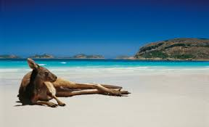
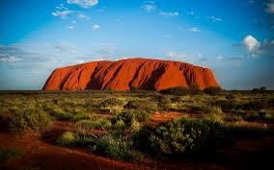
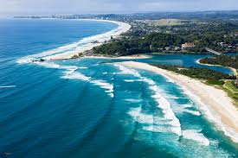
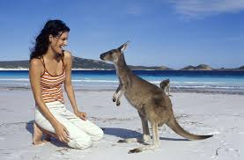

Slide 12
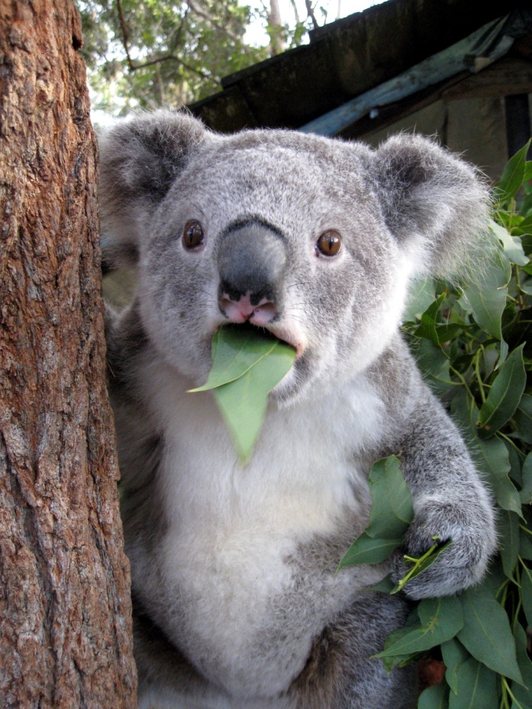
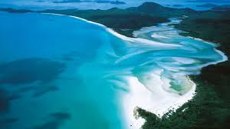
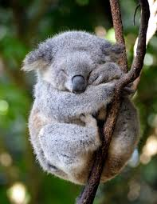
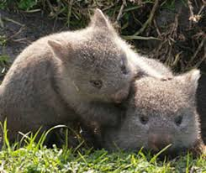

Slide 13
Thank you for your attention, Ihope it was informative.

