Slide 1
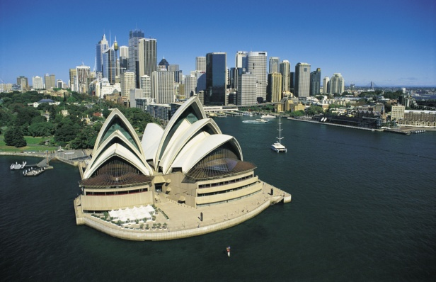
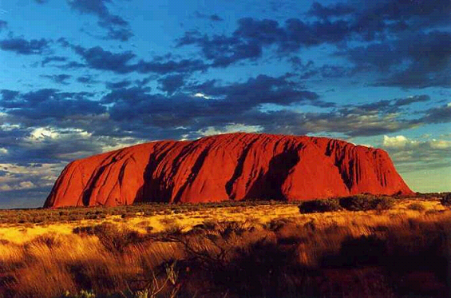
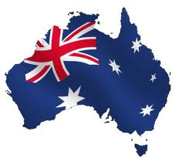
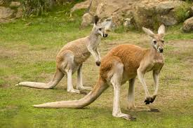
Australia is the kangaroos’ home
We give you some advice that you can do in Australia!

Slide 2
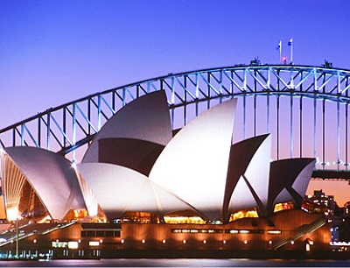
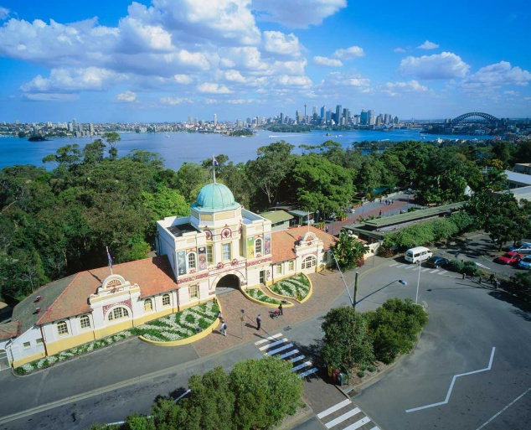
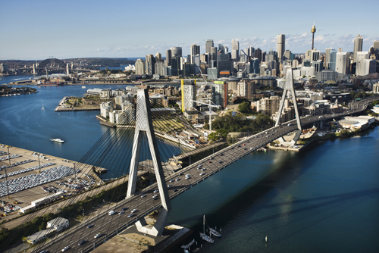
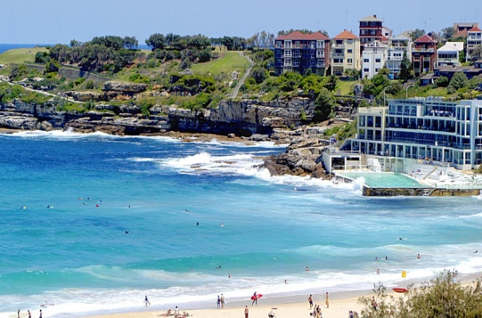
Sydney
The capital city of Australia is Melbourne, but if I were you I would visit Sydney because this is very nice city.
You should visit :
Opera House
Sydney Bridge
Taronga Zoo
Bondi Beach

Slide 3
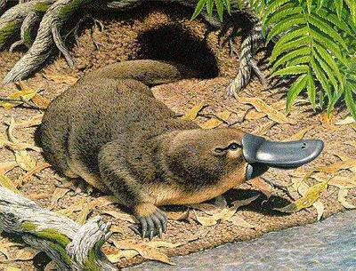
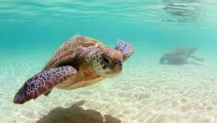
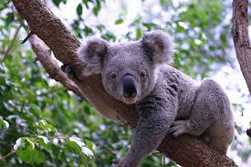
Australian wildlife
Australia has got the cutest animals in the world.
These are the most singular animals in the world wildlife.
Koala
Kangaroo
Sea Turtle
Platypus

Slide 4
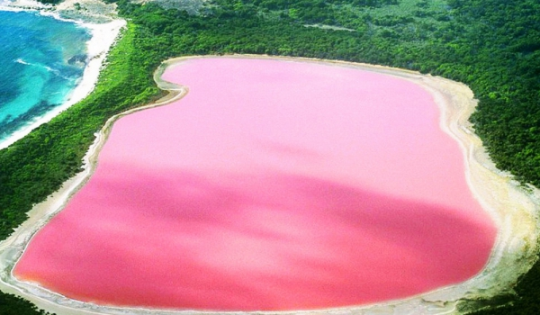
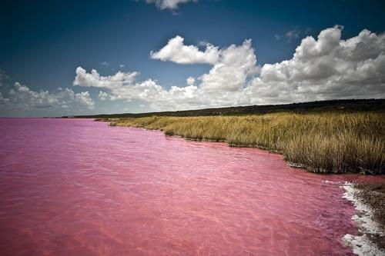
The waters of Australia
Australia has got a lot of nice seasides and lakes.
You can find here the most special lake in the world, called Lake Hillier.
This lake’s colour is pink, but nobody knows why.

Slide 5
The australian famous island Whitsunday has got a great seaside called Whitehaven, this is a beach too. This place won awards, because this beach one of the most beautiful seaside around the world.
Awards:
Best Beach in the South Pacific (2015)
Best Beach in the South Pacific and Top 5 of the world’s best beaches (2014)
Best Beach in Australia and Top 3 of the world’s best beaches (2013)
CNN.com named world’s top eco-friendly beach (2010)

Slide 6
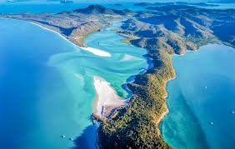
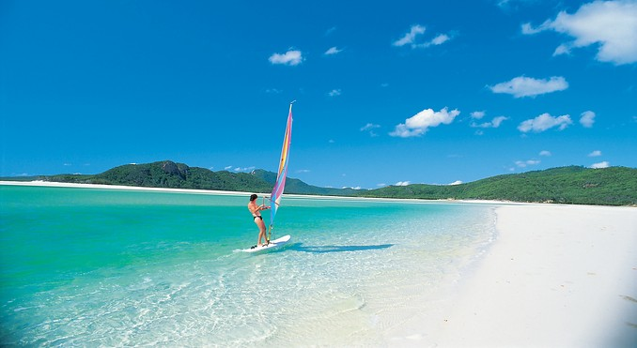
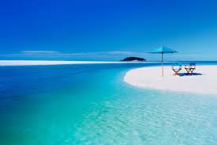
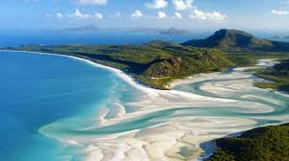
Whitehaven Beach The surfers paradise

Slide 7
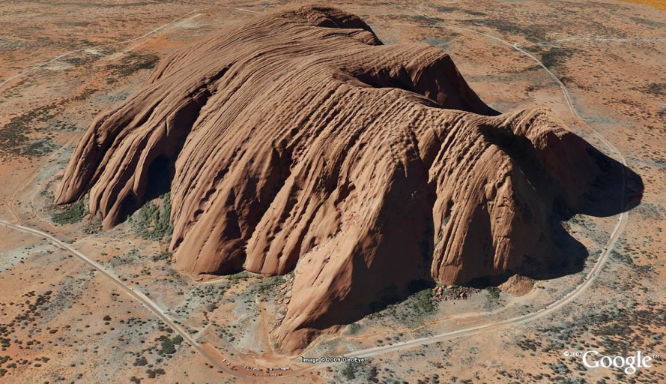
Uluru/Ayers Rock
Uluru near Alice Springs in the Northern Territory is one Australia’s most famous attractions. Also known as Ayers Rock by Europeans, it is a huge sandstone rock more than 9 km in circumference drawing many hundreds of thousands of visitors each year, particularly to see the stunning views at sunset and sunrise. Considered a sacred site by the Aboriginals, its is one of the world’s rocks, and surrounded by the stunning Uluru National park where you can see more than 100 species of birds and mammals.

Slide 8
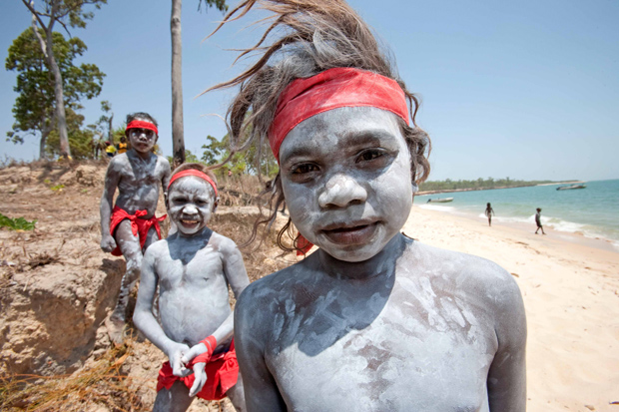
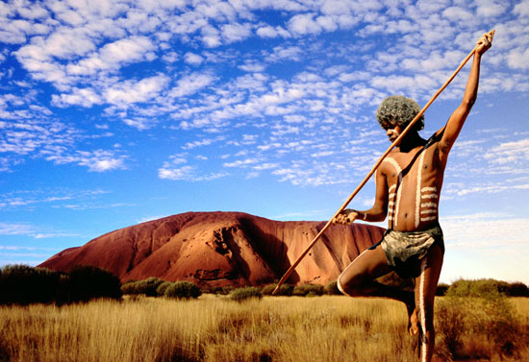
The Australian aborigines
The original aborigines lived there 70.000 years ago.
They lived around the river Murray.
These people speak English.

Slide 9
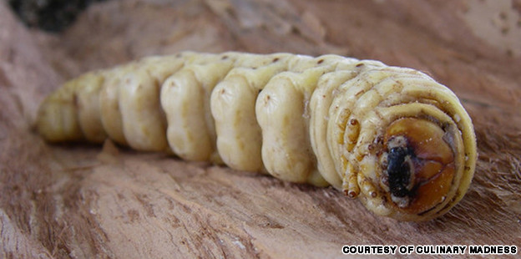
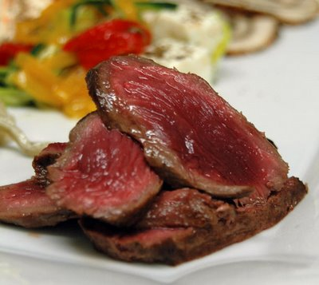
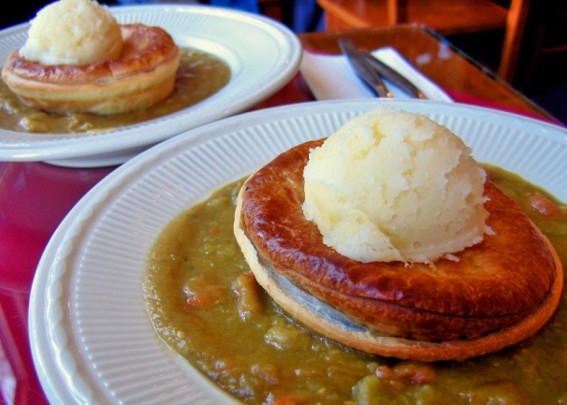
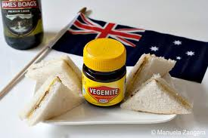
Australian traditional food
Australians have got very special foods.
Maybe this sounds strange, but they eat:
Insects
Kangaroo
Adelaide Pie Floater
Vegemite

Slide 10
I hope you like this exhibition. If i were you I would travel to Australia!!

