Slide 1
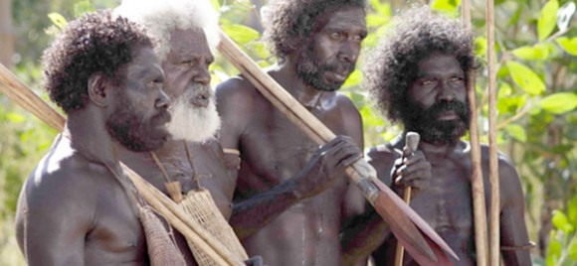
Natives in Australia
The aboriginals

Slide 2
First contact
When the first Europeans appeared in Australia, they found the native inhabitans (called aboriginals) living in the conditions of the Stone Age. The land was not cultivated, but all the time they were wandering looking for food.

Slide 3
Religious ceremonies
They lived in much closer contact with nature than any other nation in the world.
They belived in ghosts and they did ritual ceremonies. They used sacred symbols.
Today their legal position are defend with legislations to fit in to the white Australian people.

Slide 4
Persecution
It is estimated that the Australian Aboriginals have lived on the mainland for 30.000 years.
They were not considered people by the white people. The settlers chased them deeper and deeper into the wild and barren areas of the continent .
Punitive expeditions were launched against them, so they wanted to teach them how to live in a civilised way.

Slide 5
The Aboriginals kids were abducted from their parents by the white people.
The damage on their culture is huge. The restoration process is still going on.

Slide 6
Aboriginal art
Traditional Aboriginal hunting weapon is the boomerang.
Traditional Aboriginal art was inspired by religious ceremonies or rituals.
It is also one of the most interesting areas of art. It is based on totems and the Dreaming Aboriginal art is a language in itself, communicating through beautiful patterns. All the designs, painted or drawn, have a story behind them. This started around 30,000 to 40,000 years ago. The paintings are usually used with dark, earthy colours like dark brown, light brown, orange, red.
Their typical musical instrument is the didgeridoo.

Slide 7
Boomerang
The tranditional hunting weapon of the Aboriginlas is the boomerang.

Slide 8
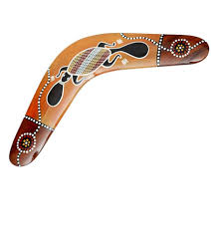
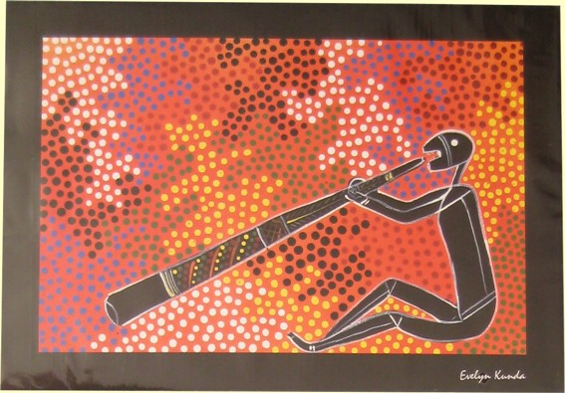
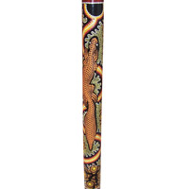
Pieces of art

Slide 9
Didgeridoo
The didgeridoo (also known as a didjeridu) is a wind instrument developed by Indigenous Australians of northern Australia potentially within the last 1,500 years and still in widespread use today both in Australia

Slide 10
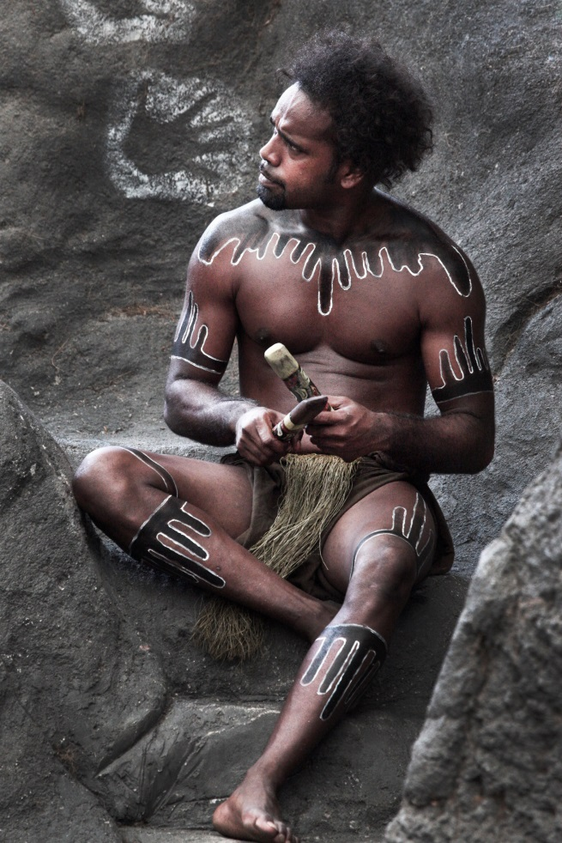
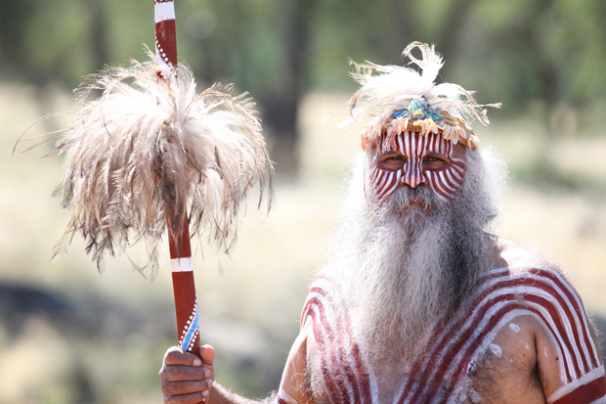
And last but not least
Pictures of Aboriginals:

